Slide 1



UNIVERSITY INSTITUTE OF ENGINEERING
COMPUTER SCIENCE ENGINEERING
Bachelor of Engineering
Design and Analysis of Algorithms(CST-311/ITT-311)
Topic: P and NP classes & proof of NP hard etc.
DISCOVER . LEARN . EMPOWER

Slide 2
Learning Objectives & Outcomes
Objective:
To understand the concept of P and NP classes & proof of NP hard and NP Completeness.
Outcome:
Student will understand
Concept of P and NP classes & proof of NP hard and NP Completeness

Slide 3
P-Class
The class P consists of those problems that are solvable in polynomial time, i.e. these problems can be solved in time O(n^{k}) in worst-case, where k is constant.
These problems are called tractable, while others are called intractable or superpolynomial.
Formally, an algorithm is polynomial time algorithm, if there exists a polynomial p(n) such that the algorithm can solve any instance of size n in a time O(p(n)).
Problem requiring Ω(n⁵⁰) time to solve are essentially intractable for large n. Most known polynomial time algorithm run in time O(n^{k}) for fairly low value of k.

Slide 4
NP-Class
The class NP consists of those problems that are verifiable in polynomial time. NP is the class of decision problems for which it is easy to check the correctness of a claimed answer, with the aid of a little extra information. Hence, we aren’t asking for a way to find a solution, but only to verify that an alleged solution really is correct.
Every problem in this class can be solved in exponential time using exhaustive search.

Slide 5
P versus NP-Class
Every decision problem that is solvable by a deterministic polynomial time algorithm is also solvable by a polynomial time non-deterministic algorithm.
All problems in P can be solved with polynomial time algorithms, whereas all problems in NP - P are intractable.
It is not known whether P = NP. However, many problems are known in NP with the property that if they belong to P, then it can be proved that P = NP.
If P ≠ NP, there are problems in NP that are neither in P nor in NP-Complete.
The problem belongs to class P if it’s easy to find a solution for the problem. The problem belongs to NP, if it’s easy to check a solution that may have been very tedious to find.

Slide 6
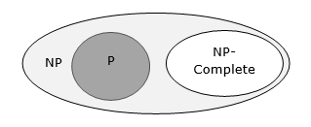
NP-hard and NP-completeness
A problem is in the class NPC if it is in NP and is as hard as any problem in NP. A problem is NP-hard if all problems in NP are polynomial time reducible to it, even though it may not be in NP itself.
If a polynomial time algorithm exists for any of these problems, all problems in NP would be polynomial time solvable. These problems are called NP-complete. The phenomenon of NP-completeness is important for both theoretical and practical reasons.

Slide 7
NP-Complete Problems
Following are some NP-Complete problems, for which no polynomial time algorithm is known.
Determining whether a graph has a Hamiltonian cycle
Determining whether a Boolean formula is satisfiable, etc.

Slide 8
NP-Hard Problems
The following problems are NP-Hard
The circuit-satisfiability problem
Set Cover
Vertex Cover
Travelling Salesman Problem
In this context, now we will discuss TSP is NP-Complete

Slide 9
TSP is NP-Complete
The traveling salesman problem consists of a salesman and a set of cities. The salesman has to visit each one of the cities starting from a certain one and returning to the same city. The challenge of the problem is that the traveling salesman wants to minimize the total length of the trip

Slide 10
Proof
To prove TSP is NP-Complete, first we have to prove that TSP belongs to NP. In TSP, we find a tour and check that the tour contains each vertex once. Then the total cost of the edges of the tour is calculated. Finally, we check if the cost is minimum. This can be completed in polynomial time. Thus TSP belongs to NP.
Secondly, we have to prove that TSP is NP-hard. To prove this, one way is to show that Hamiltonian cycle ≤_{p} TSP (as we know that the Hamiltonian cycle problem is NPcomplete).

Slide 11
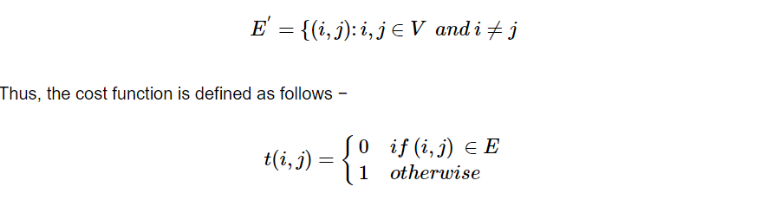
Proof (Contd.)
Assume G = (V, E) to be an instance of Hamiltonian cycle.
Hence, an instance of TSP is constructed. We create the complete graph G' = (V, E'), where
Now, suppose that a Hamiltonian cycle h exists in G. It is clear that the cost of each edge in h is 0 in G' as each edge belongs to E. Therefore, h has a cost of 0 in G'. Thus, if graph G has a Hamiltonian cycle, then graph G' has a tour of 0 cost.

Slide 12
Proof (contd.)
Conversely, we assume that G' has a tour h' of cost at most 0. The cost of edges in E' are 0 and 1 by definition. Hence, each edge must have a cost of 0 as the cost of h' is 0. We therefore conclude that h' contains only edges in E.
We have thus proven that G has a Hamiltonian cycle, if and only if G' has a tour of cost at most 0. TSP is NP-complete.

Slide 13
REFERENCES
Text books:
Cormen, Leiserson, Rivest, Stein, “Introduction to Algorithms”, Prentice Hall of India, 3rd edition 2012. problem, Graph coloring.
Websites:
https://www.tutorialspoint.com/design_and_analysis_of_algorithms/design_and_analysis_of_algorithms_p_np_class.htm
https://www.tutorialspoint.com/design_and_analysis_of_algorithms/design_and_analysis_of_algorithms_np_hard_complete_classes.htm
https://www.javatpoint.com/daa-complexity-classes

Slide 14
Summary
P And NP Classes
Proof of NP-hard and NP-completeness

Slide 15
THANK YOU

